Slide 1
CAPITAL BUDGETING TECHNIQUES

Slide 2
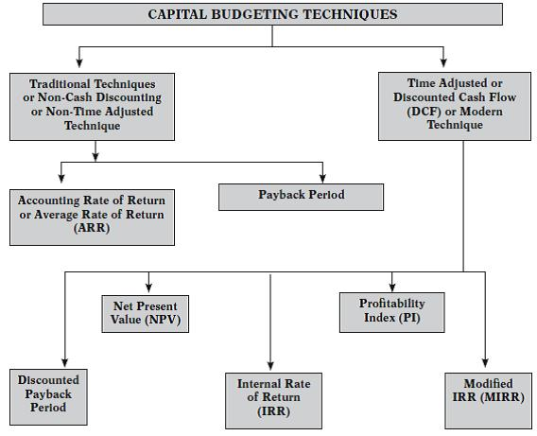

Slide 3
Conventional or Traditional Techniques of Capital Budgeting
Payback Period
Payback period represents the time period required for complete recovery of the initial investment in the project. It is the period within which the total cash inflows from the project equals to the cost of project. The lower the payback, the better it is, since initial investment is recouped faster.

Slide 4
Computation of Simple Payback Period
Determine the total outflow of the project (Initial Investment).
Determine the Cash Inflow After Taxes (CFAT) for each year.
Determine the Cumulative CFAT at the end of every year.
Determine the year in which cumulative CFAT exceeds initial investment.
Compute payback period as under
= Initial Investment/CFAT per annum.
Accept, if payback period is less than maximum or benchmark period, else reject the project.

Slide 5
advantages
Simple and easy.
It gives indication of Liquidity.
It deals with risk also, the project with a shorter payback period will be less risky as compared to project with longer payback period as the cash inflow which arise further in future will be less certain and hence more risky.

Slide 6
Disadvantages
It ignores what happens after the initial investment is recovered.
It ignores the time value of money.
It ignores the Salvage value.
This is only the method of capital recovery and not to know the profit . Only capital recovery is not enough because from economic point of view profit is the main indicator.

Slide 7
Discounted Payback Period
When the payback period is computed after discounting the cash flows by a predetermined rate, then it is called as the discounted payback period. For calculating payback period, we need Cash Flow After Tax (CFAT).

Slide 8
Computation of Discounted Payback Period
Determine the total outflow of the project.
Determine the Cash Flow After Taxes (CFAT) for each year.
Determine the PV factor for each year.
Compute discounted CFAT by multiplying step 2 and step 3.
Determine the cumulative discounted CFAT at the end of every year.
Determine the year in which cumulative DCFAT exceeds initial investment.
Compute discounted payback period at the time at which cumulative DCFAT= Initial investment.
Accept, if discounted payback period is less than maximum/bench mark period, else reject the proposal.

Slide 9
Net Present Value Method
The Net Present Value (NPV) of an investment proposal is defined as the sum of the present value of all future cash inflows less the sum of the present value of all cash outflows associated with the proposal.
Net present value = Discounted cash inflow - Discounted cash outflow

Slide 10
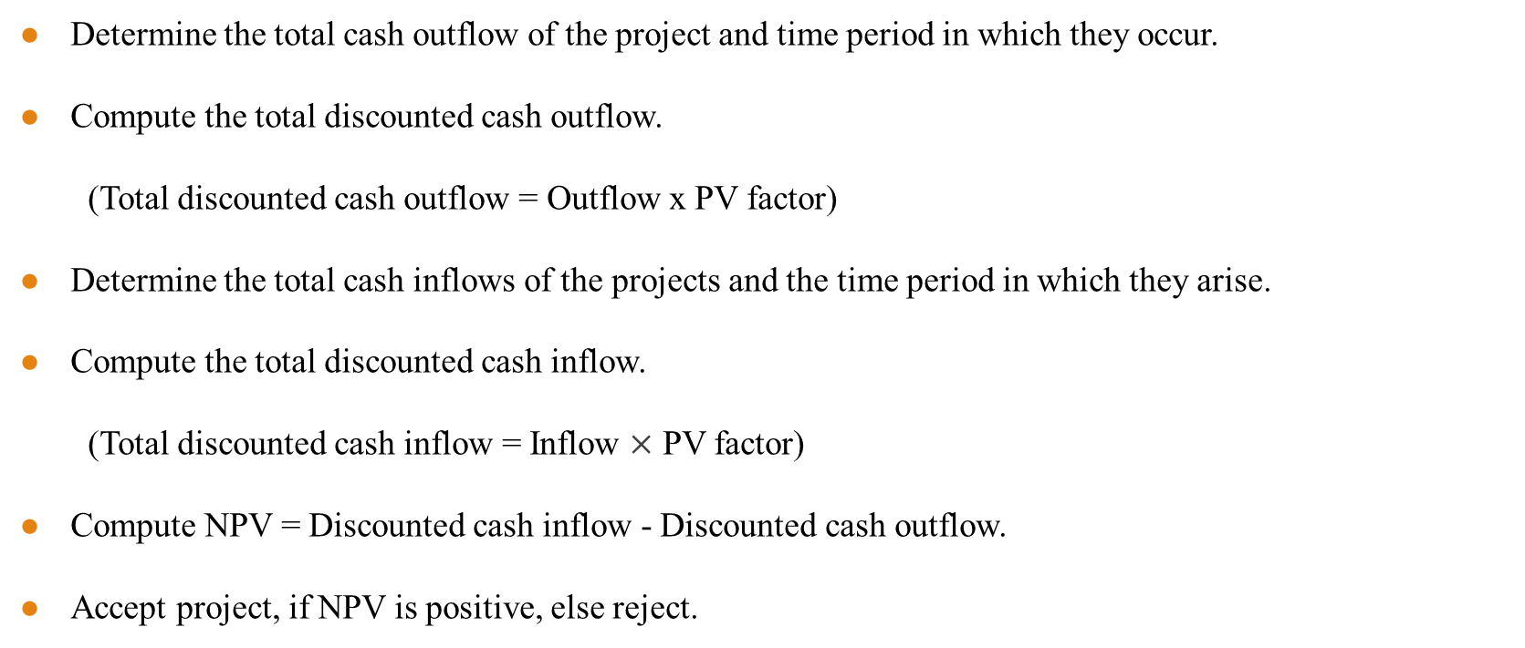
Computation of Net Present Value
Determine the total cash outflow of the project and time period in which they occur.
Compute the total discounted cash outflow.
(Total discounted cash outflow = Outflow x PV factor)
Determine the total cash inflows of the projects and the time period in which they arise.
Compute the total discounted cash inflow.
(Total discounted cash inflow = Inflow $×$ PV factor)
Compute NPV = Discounted cash inflow - Discounted cash outflow.
Accept project, if NPV is positive, else reject.

Slide 11

Profitability Index or Desirability Factor
The profitability index is used where different investment proposals each involving different initial investments and cash inflows due, to be compared.
= $\frac{Total discounted cash inflows}{Total discounted cash outflows}$

Slide 12
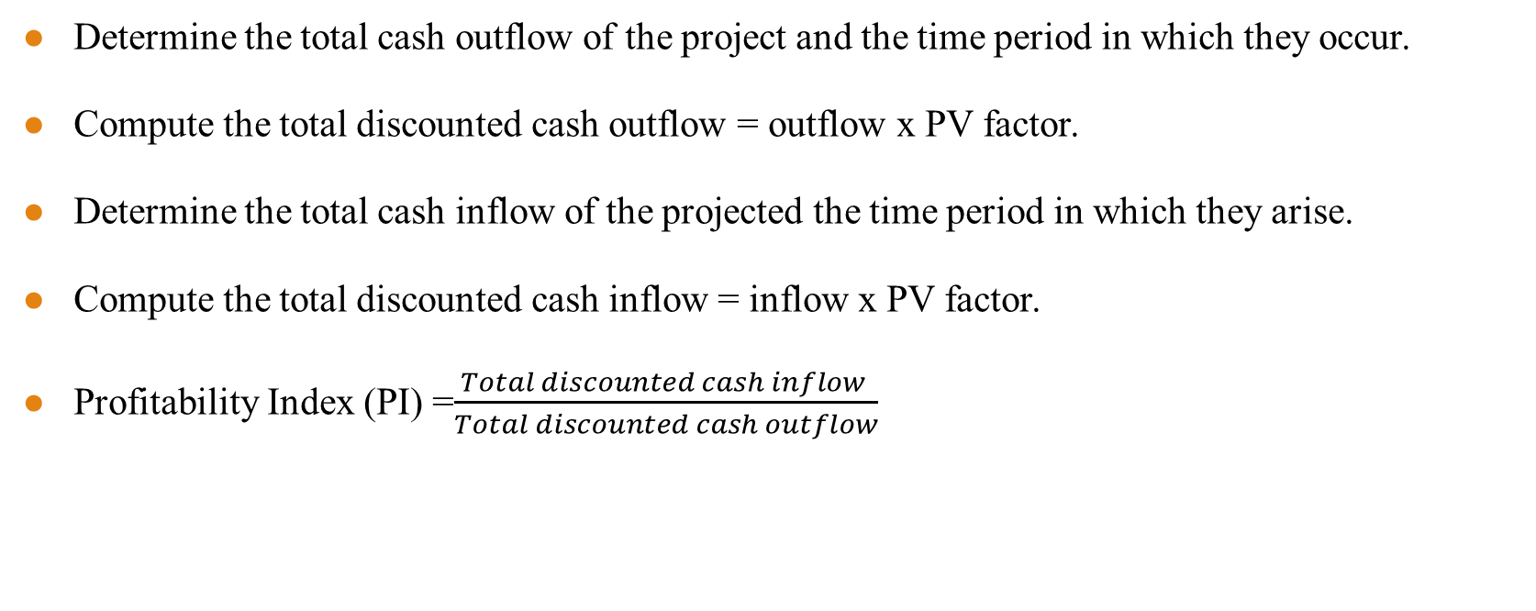
Computation of Profitability Index
Determine the total cash outflow of the project and the time period in which they occur.
Compute the total discounted cash outflow = outflow x PV factor.
Determine the total cash inflow of the projected the time period in which they arise.
Compute the total discounted cash inflow = inflow x PV factor.
Profitability Index (PI) =$\frac{Total discounted cash inflow }{Total discounted cash outflow}$

Slide 13
Internal Rate of Return (IRR)
Internal rate of return is the rate where the sum total of discounted cash outflow is equal to total of discounted cash inflow. At this point, the total NPV is zero.
Discounted cash inflows = Discounted cash outflows.
Hence, NPV = 0

Slide 14
Computation of Internal Rate of Return
Determine the total cash outflows and the time period in which they occur.
Determine the total cash inflows of the project and the time in which they arise.
Compute the NPV at an arbitrary discount rate.
Choose another discount rate and compute NPV.
The second discount rate is chosen in such a way that if first NPV is positive, then choose higher discount rate and if NPV is negative, then choose lower discount rate.
Compute the change in NPV over the two selected discounted rates.
Compute the discount rate on proportionate basis at which NPV is zero.

